Slide 1
Book Inventory Management System
Xie Wenhao (Group Leader)
Mario Uesaka

Slide 2


The bottleneck / Solution

Slide 3
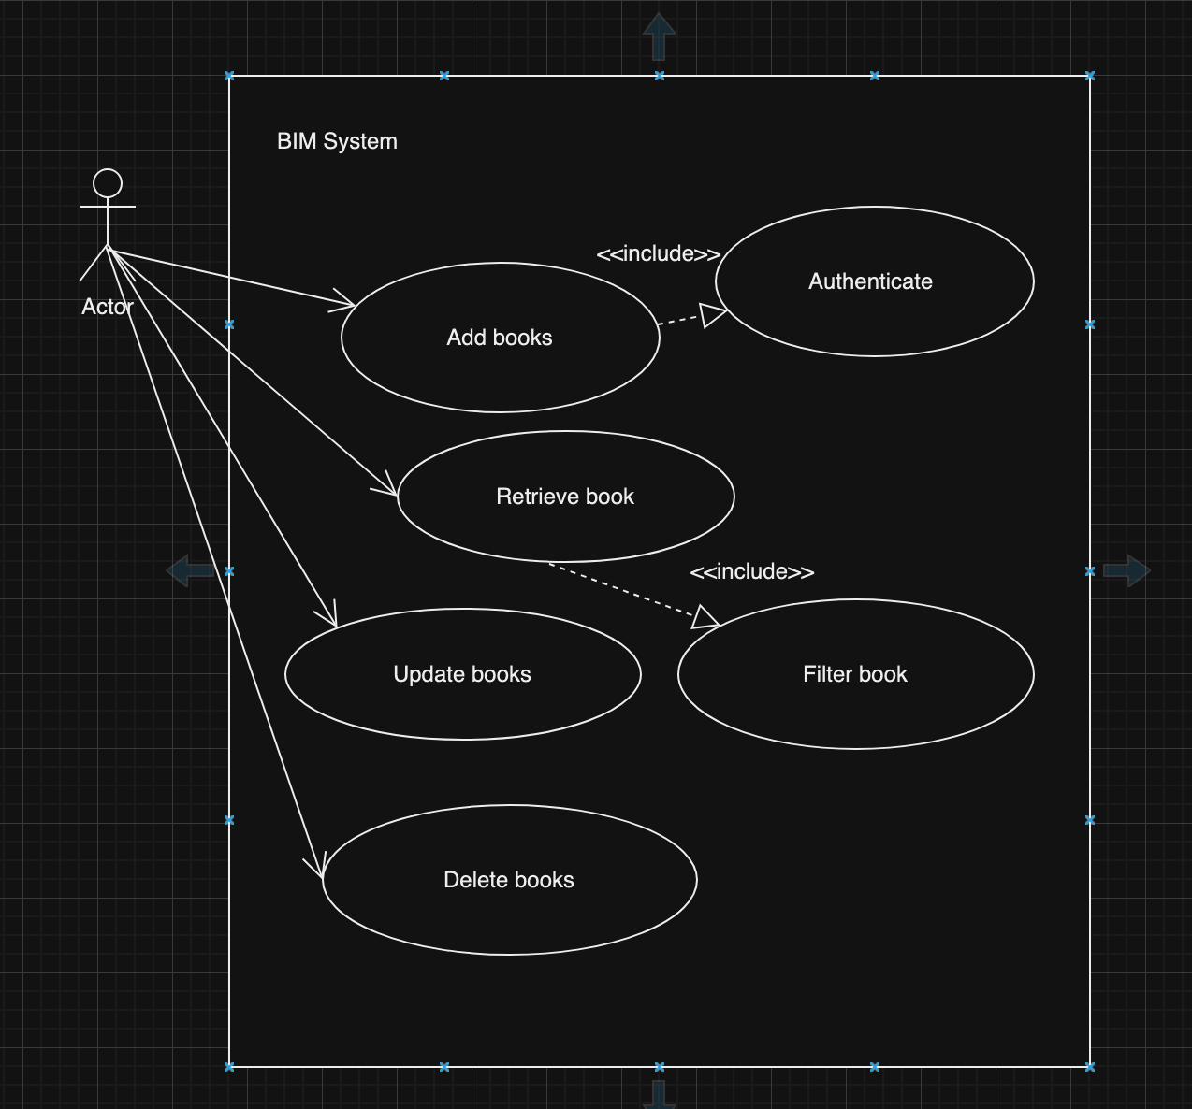
Use case diagram
Functional behaviour of the system
A user is the actor
The system allows:
Add, Retrieve, Delate and update

Slide 4
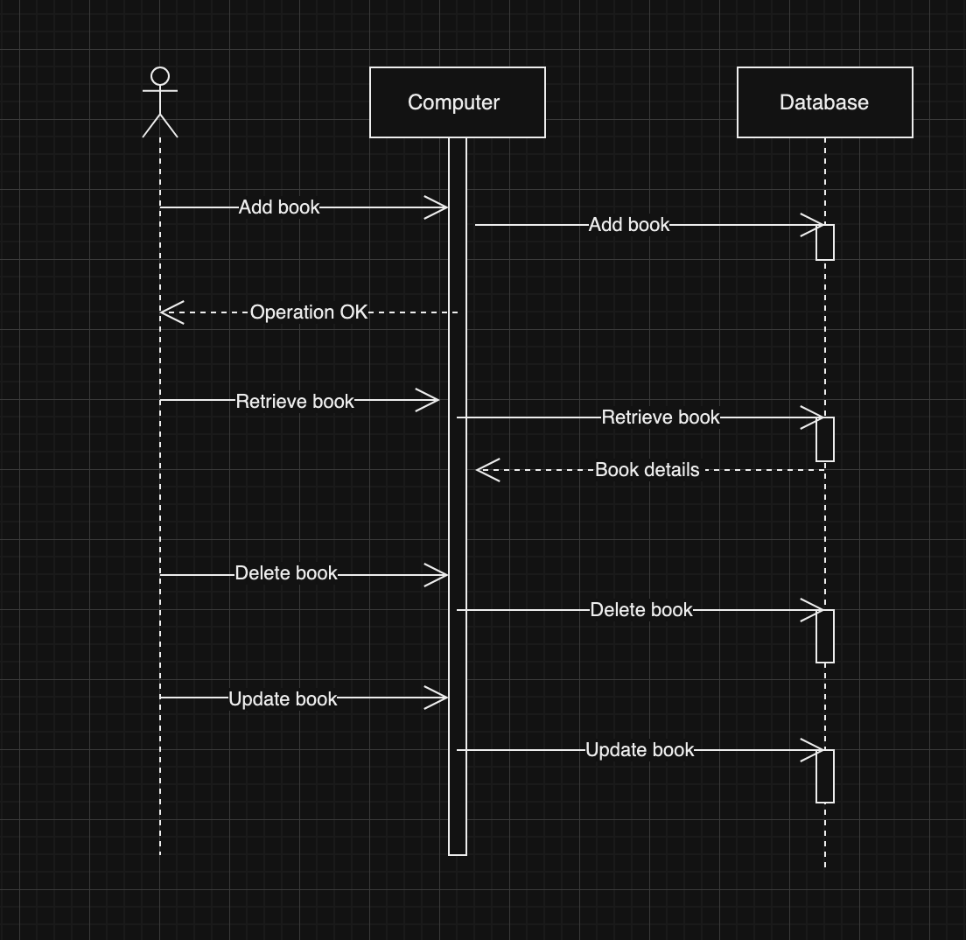
Sequence Diagram
Sequence of the events
Actor, Computer and Database

Slide 5
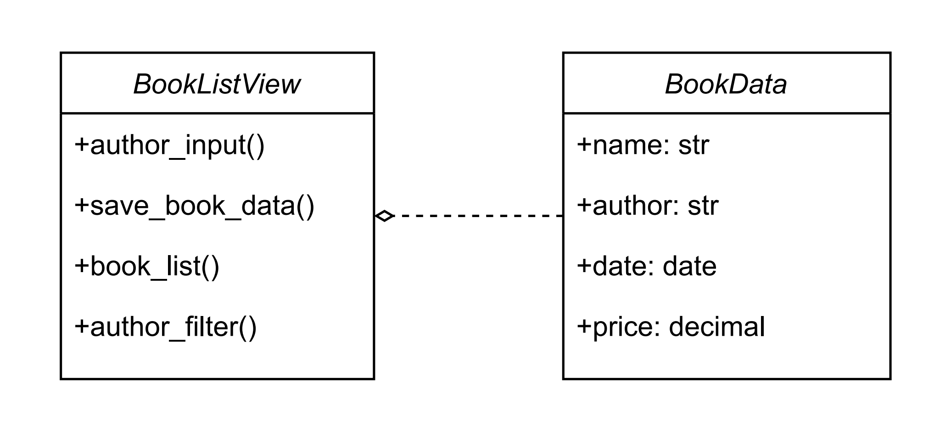
Class diagram

Slide 6
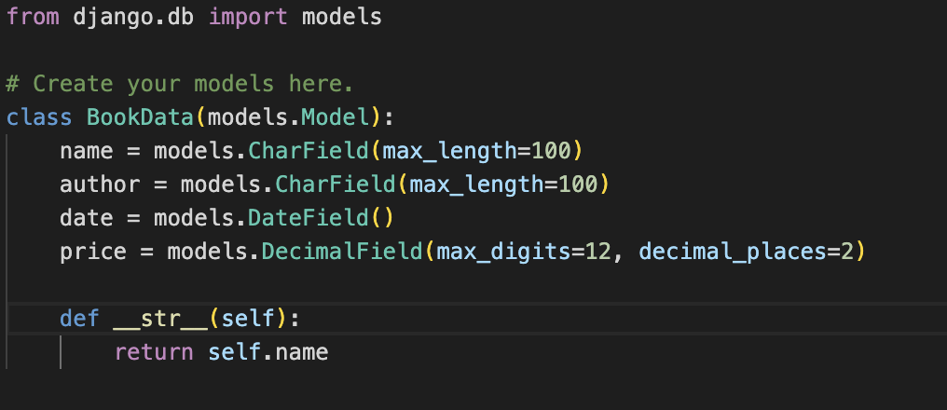
Program Code Section
Define relationships between entities
(Book:Name, Author, Date, Price)

Slide 7
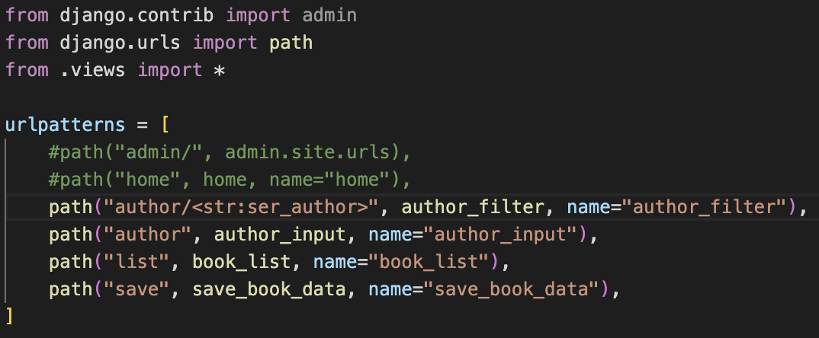
Program Code Section
Link the requested URL address to the corresponding views.

Slide 8
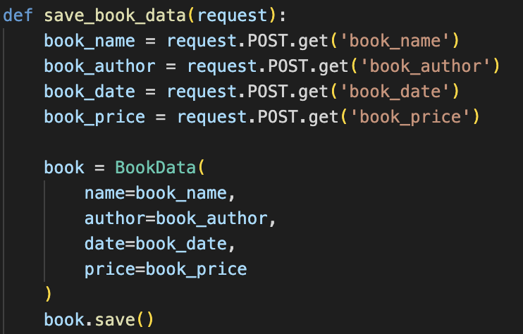
Program Code Section
This function is used to retrieve book data and save it to the database.(Name, Author, Date, Price)

Slide 9
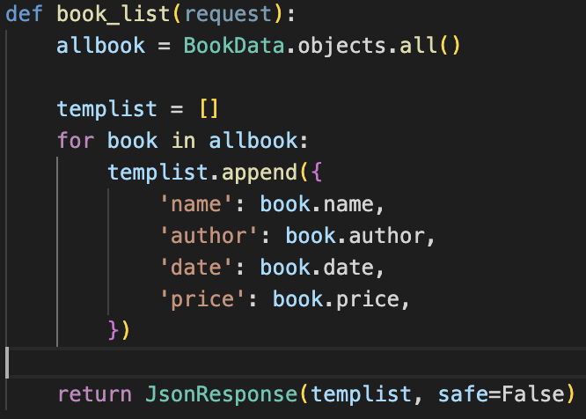
Program Code Section
This function is to retrieve all book data from the database and return it in JSON format.

Slide 10
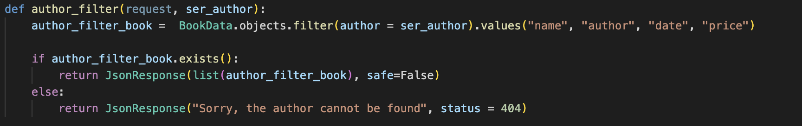
Program Code Section
This function is to filter all books by the given author name (ser_author) in the database and return the information of those books. If no books by the author are found, it returns an error.

Slide 11
Test Section
We created data for four books using test.py and tested the above methods based on the number and information of the books. The test code and results are shown in the following image.

Slide 12
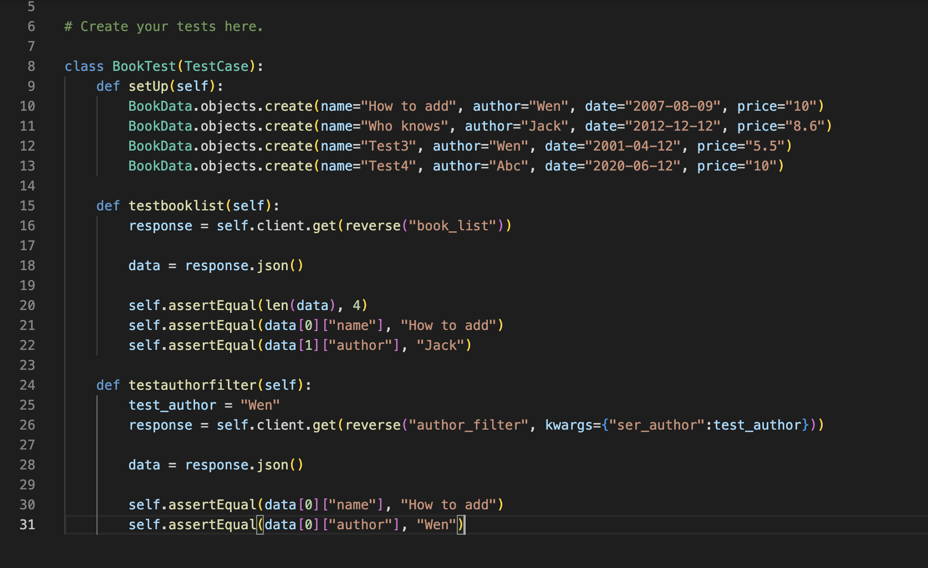

Slide 13
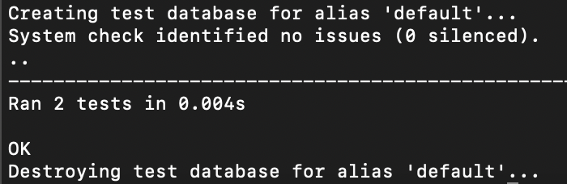
Test Result

Slide 14
Challenges and lesson learned

